Slide 1
Project Summary: End-To-End-Sales-Analysis
Project Overview : This project provides a 360-degree analysis of an E-commerce marketplace using SQL and Python.
The Objective: To extract fundamental business metrics, analyze sales trends, and generate strategic, customer-centric insights (like YoY growth and retention rates) to support data-driven decision-making.
Tools & Technologies Used:
SQL (MySQL Workbench): Data extraction, joining multiple tables, and initial aggregations of marketplace metrics.
Python (Google Colab) environment utilizing Pandas for data cleaning, Matplotlib and Seaborn for advanced trend visualizations.

Slide 2
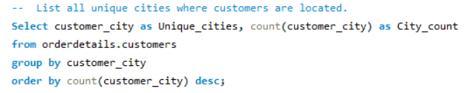
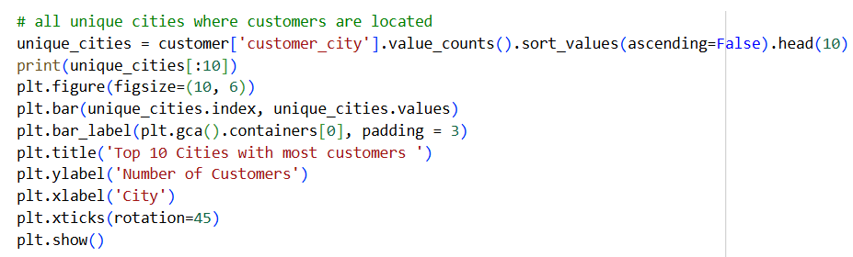
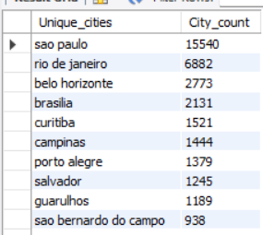
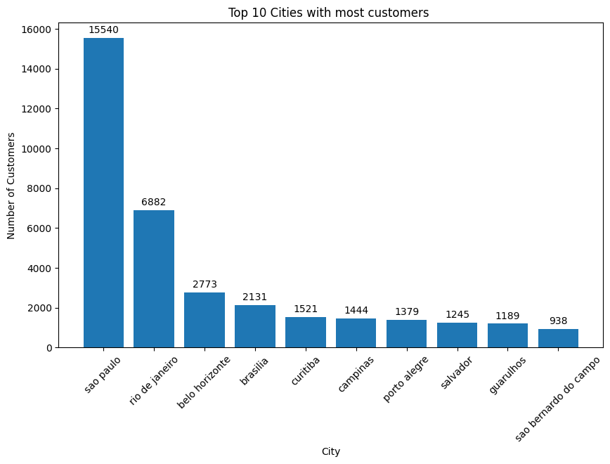
1. List all unique cities where customers are located.
Analysis and visualizations :
Insight: Most of our customers live in Sao Paulo. We should focus our marketing and fast delivery services in this city.

Slide 3
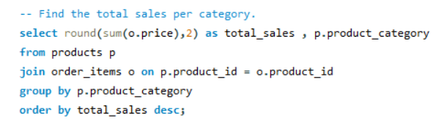
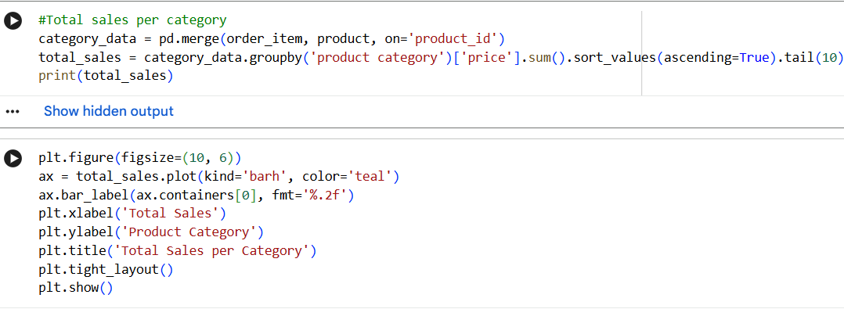
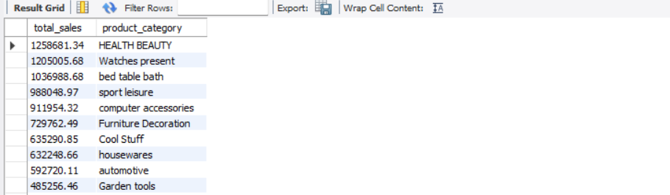
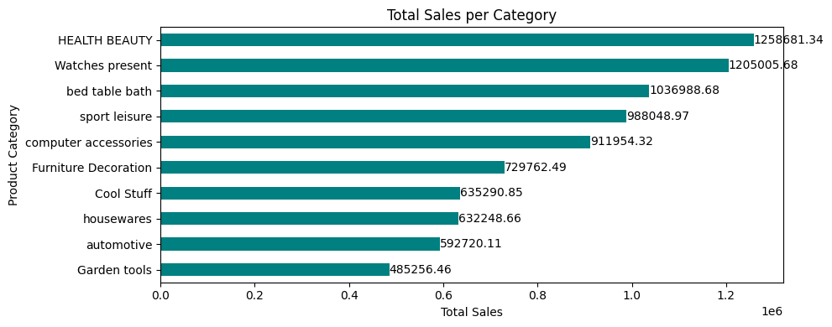
2. Find the total sales per category.
Insight: "Health Beauty" and "Watches" generate the highest sales. We should promote these items more on the homepage.

Slide 4
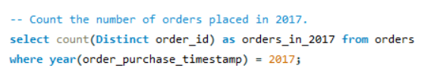
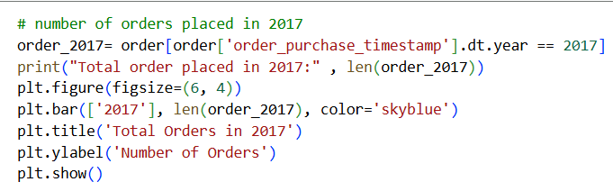
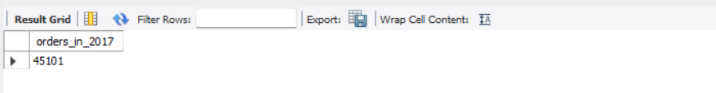
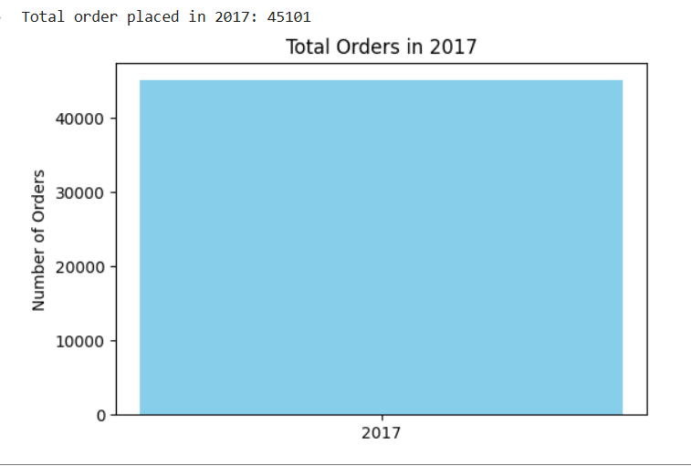
3. Count the number of orders placed in 2017.
Insight: We received 45,101 orders in 2017. We can use this number to set our sales targets for next year

Slide 5
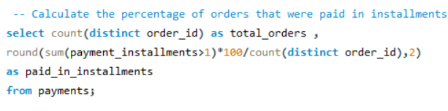
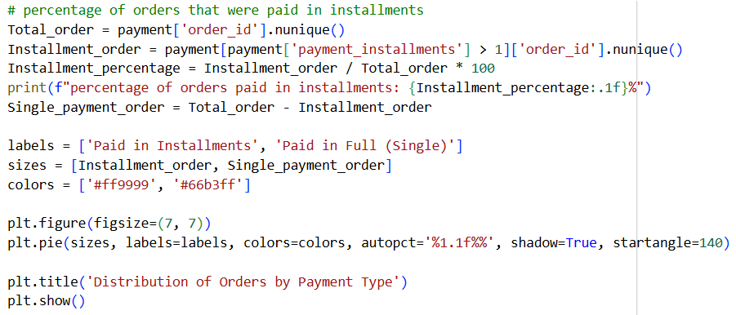
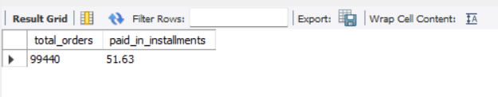
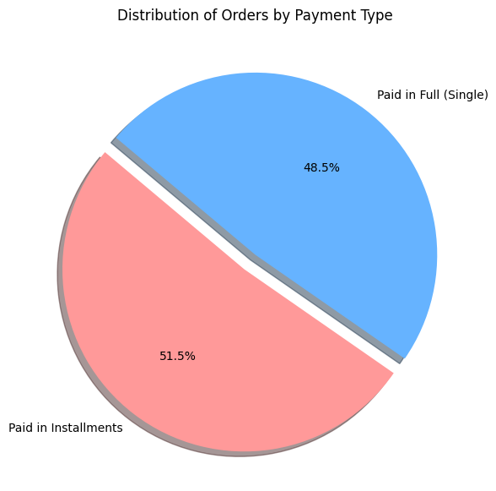
4. Calculate the percentage of orders that were paid in installments.
Insight: Around 51% of customers choose to pay in installments. Keeping this payment option is extremely important to avoid losing sales.

Slide 6
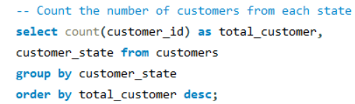
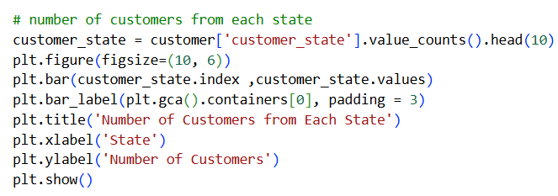
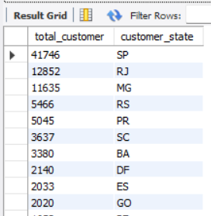
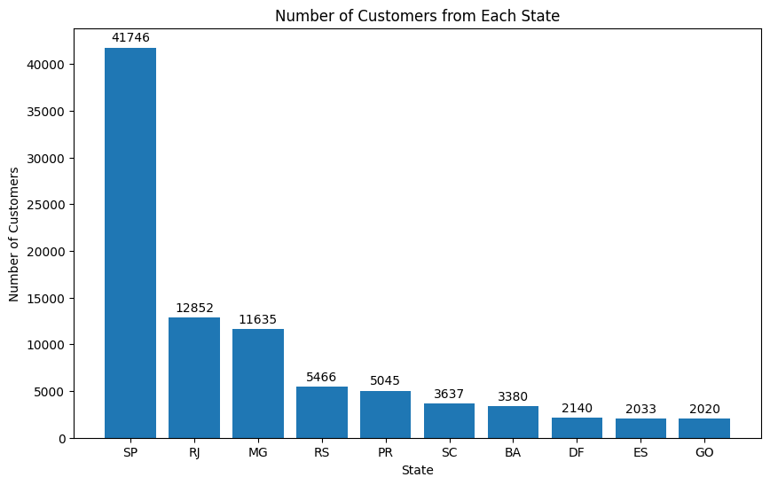
5. Count the number of customers from each state
Insight: The state of Sao Paulo has the most customers by a huge margin. We are very strong in this region compared to others.

Slide 7
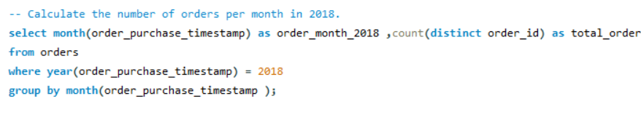
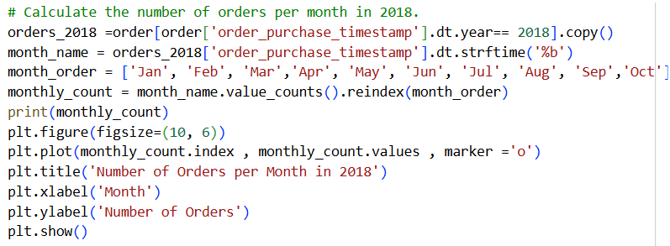
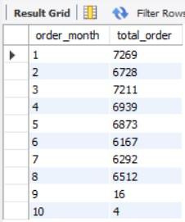
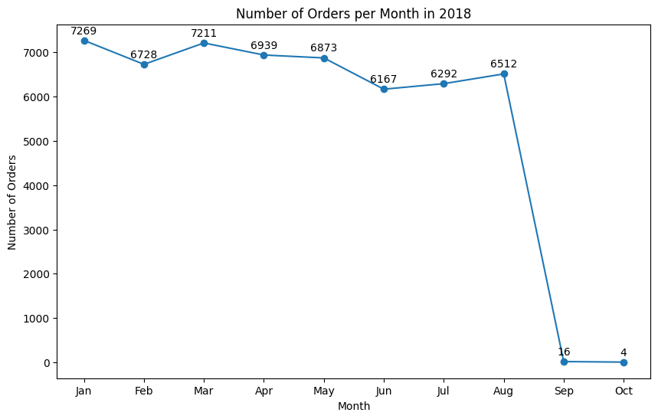
6. Calculate the number orders per month in 2018
Insight: Orders were very steady (around 6,000 to 7,000 a month) until August. The sudden drop in September and October is likely just incomplete data, not a real drop in sales.

Slide 8
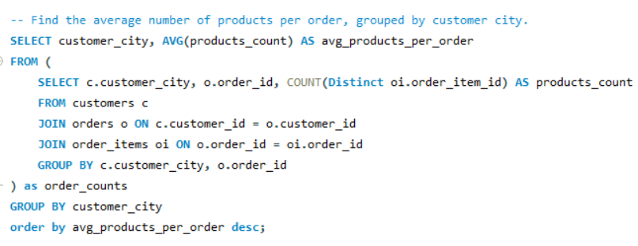
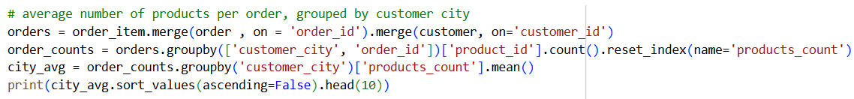
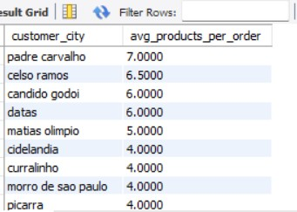
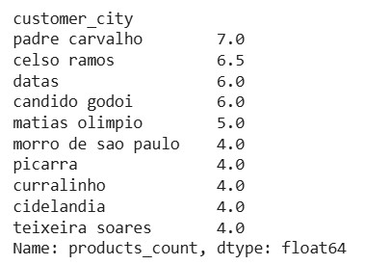
7. Find the average number of products per order, grouped by customer city.
Insight: Customers in some smaller cities buy many items at once (an average of 7 items per order). These might be wholesale buyers or small businesses.

Slide 9
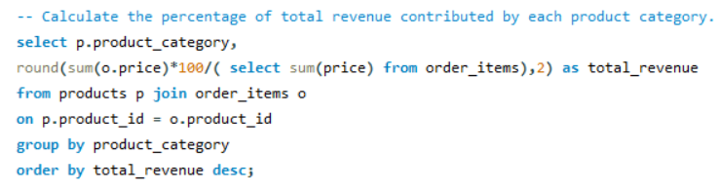
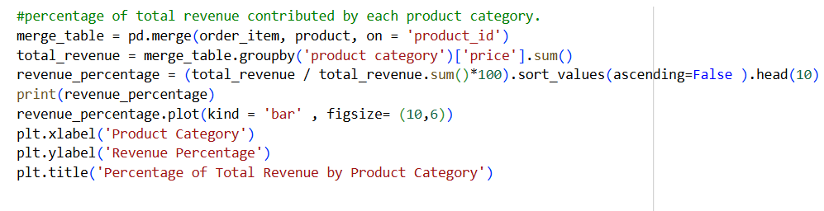
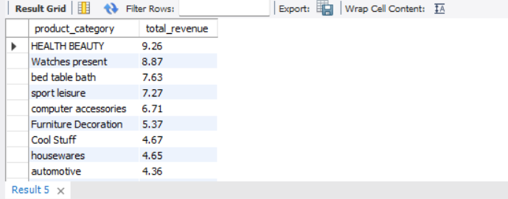
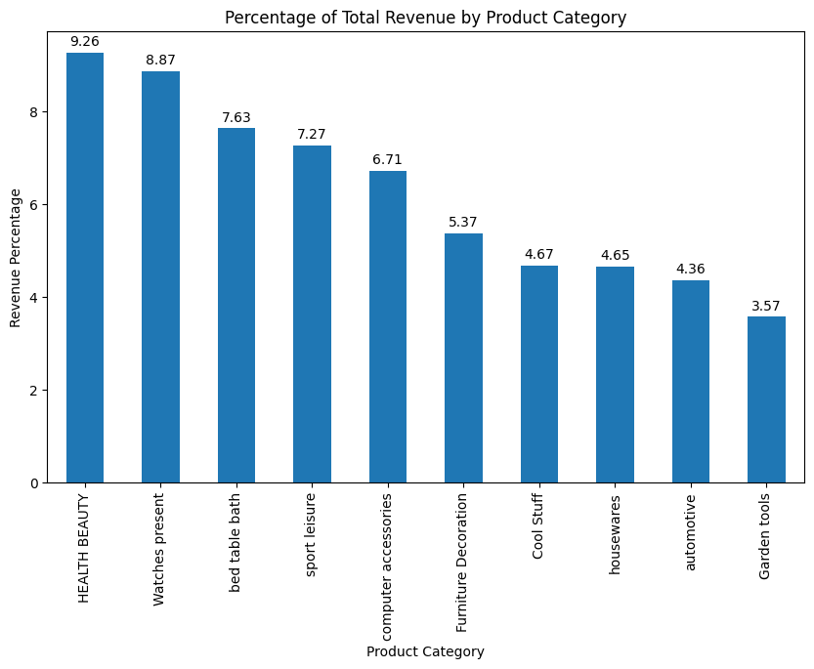
8. Calculate the percentage of total revenue contributed by each product category.
Insight: Our sales are nicely balanced across many categories. The top category only makes up 9.26% of revenue, meaning we aren't completely dependent on just one type of product.

Slide 10
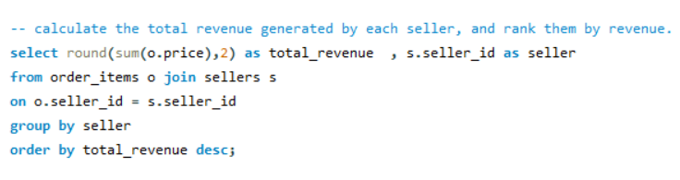
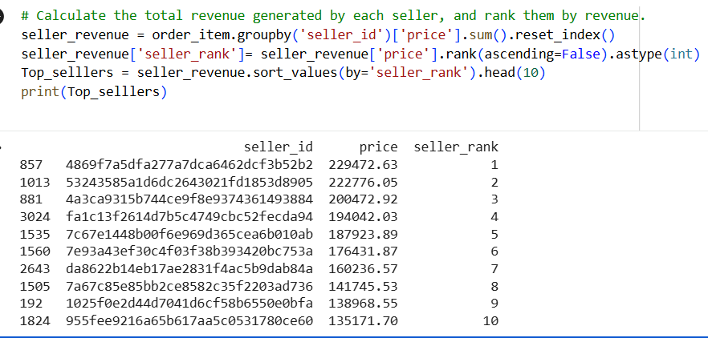
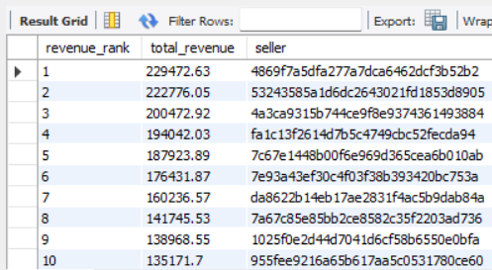
9. Calculate the total revenue generated by each seller, and rank them by revenue.
Insight: A few top sellers are bringing in the most money. We need to make sure these top sellers get good support so they don't leave our platform.

Slide 11
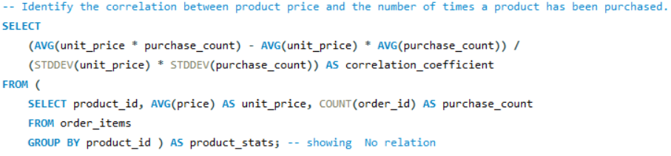
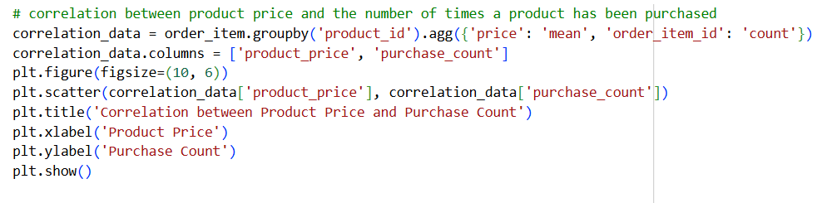
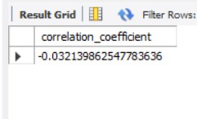
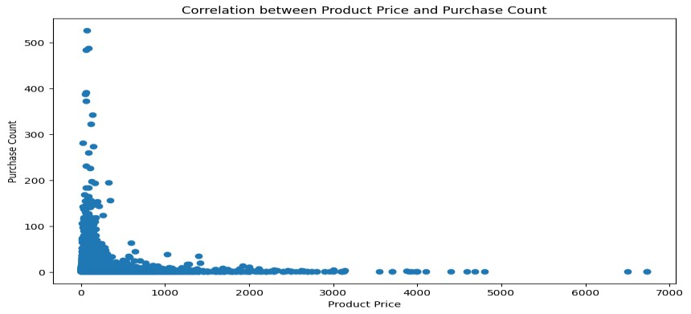
10. Identify the correlation between product price and the number of times a product has been purchased.
Insight: There is no connection between an item's price and how often it is bought. Cheaper items do not automatically sell faster than expensive ones.

Slide 12
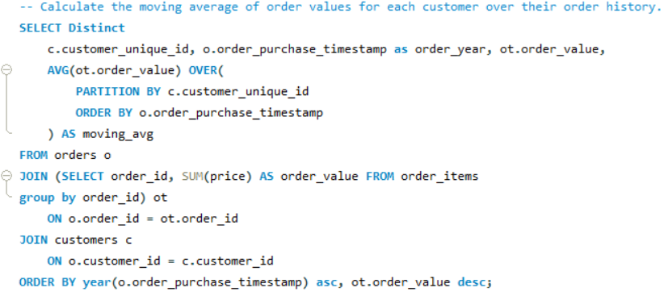
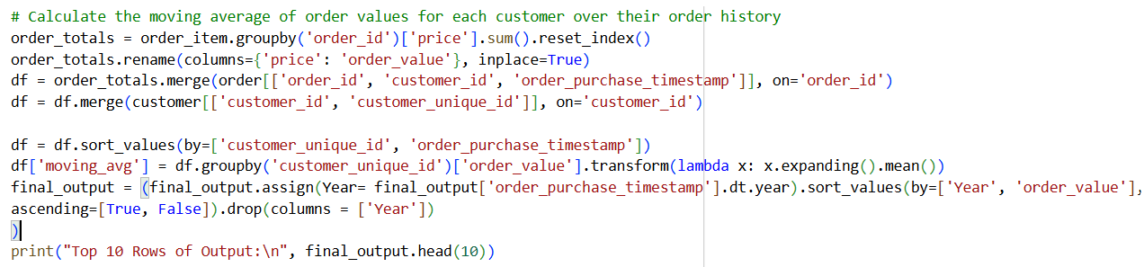
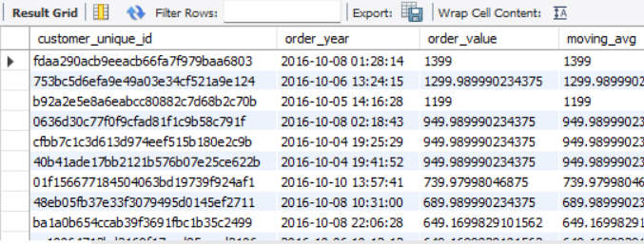
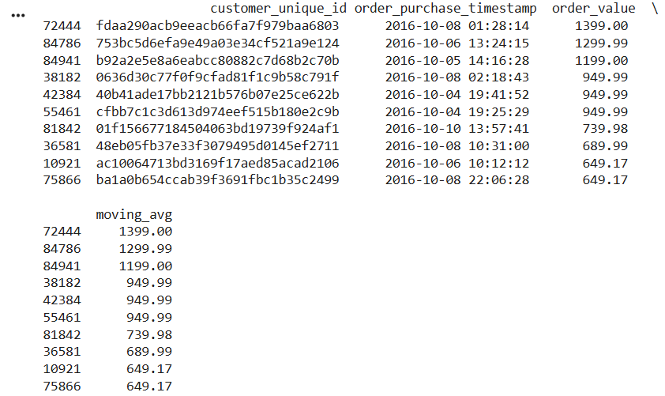
11. Calculate the moving average of order values for each customer over their order history.
Insight : Tracking the moving average helps us see the normal spending habits of customers, ignoring sudden spikes from random large orders.

Slide 13
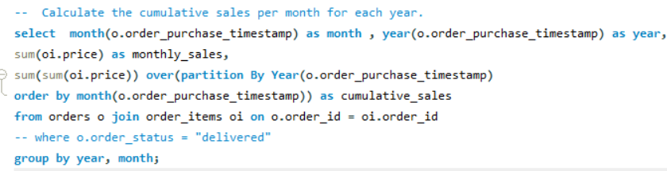
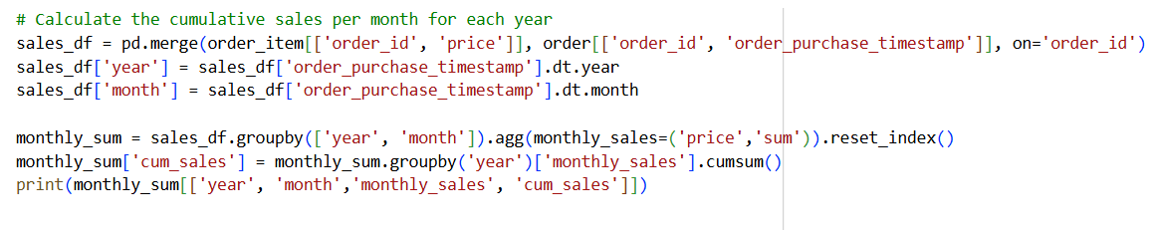
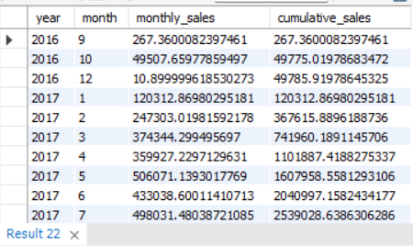
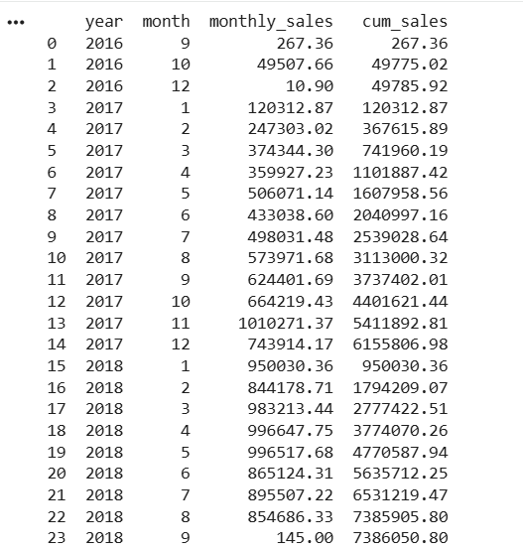
12. Calculate the cumulative sales per month for each year.
Insight: Sales grew steadily month after month in 2017. This shows healthy, continuous growth without any slow periods.

Slide 14
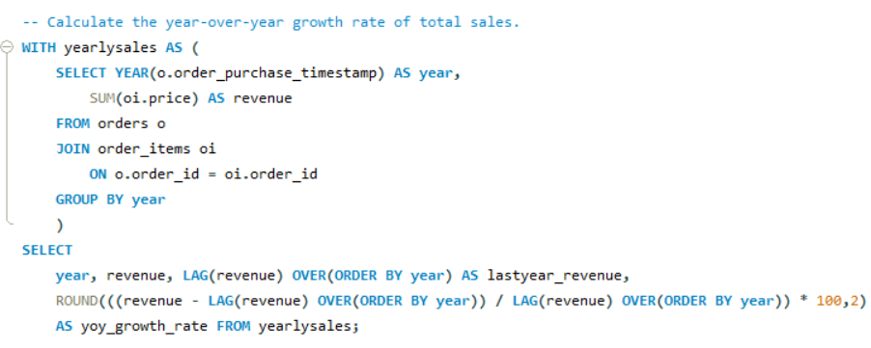
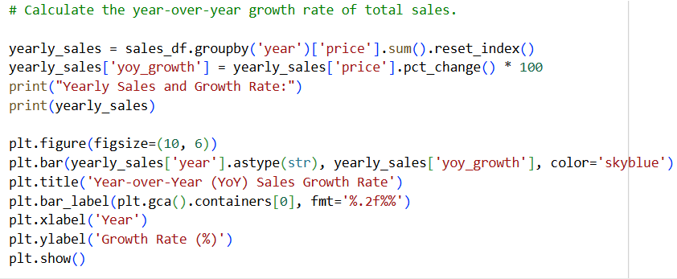
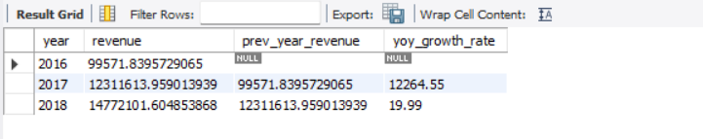

13. Calculate the year-over-year growth rate of total sales.
Insight: The massive 12,264% growth in 2017 likely means we only have a tiny bit of data for 2016. The 20% growth in 2018 is a much more realistic picture of how the business is doing.

Slide 15



14. Calculate the retention rate of customers, defined as the percentage of customers who make another purchase within 6 months of their first purchase.
Insight:Our analysis shows a 0% retention rate, indicating that first-time buyers are not returning to make a second purchase within 6 months. We need to implement targeted email marketing and loyalty programs to incentivize repeat shopping and improve customer loyalty.

Slide 16



15. Identify the top 3 customers who spent the most money in each year.
Insight: A few key customers spend a huge amount of money. We should offer them VIP discounts to thank them and keep them loyal.

Slide 17
Key Business Recommendations:
Focus Marketing on Sao Paulo: The data clearly shows Sao Paulo is our strongest market. We should allocate the largest portion of our advertising budget and offer faster shipping options in this specific region to maximize sales.
Promote Installment Options: With over 50% of orders paid in installments, this feature is critical to our success. We should make "Pay in Installments" highly visible on every product page to encourage more people to buy.
Create a VIP Seller Program: A small group of top sellers generates most of the revenue. We should assign them dedicated support managers or give them lower platform fees to ensure they don't leave for a competitor.
Launch a Customer Retention Campaign: Since 0% of retention rate, indicating that first-time buyers are not returning to make a second purchase within 6 months. we urgently need to create an automated email campaign offering a special discount for a customer's second purchase.

